Slide 1
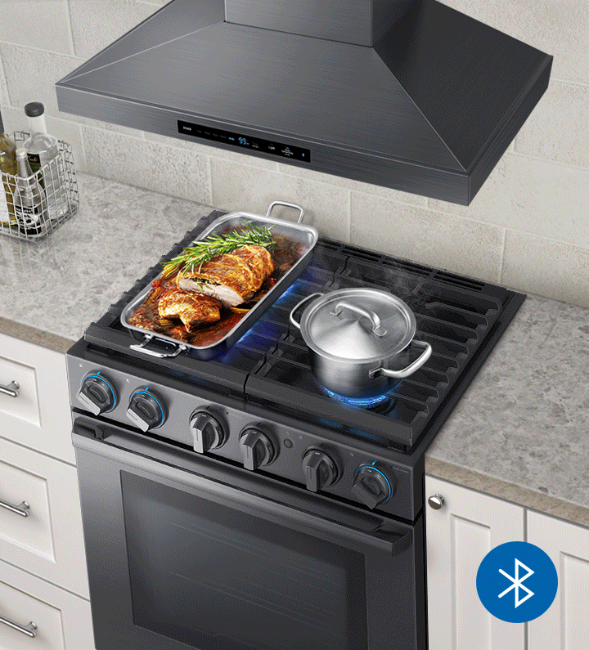
CONNECT
- MAKE LIFE SIMPLER

Slide 2
QUICK DESCRIPTION
Our company is a IoT and home automation company.
We design an advanced smart hub technology that enables users to interconnect and remotely monitor all cooking devices and kitchen appliances through a single user-friendly platform.

Slide 3
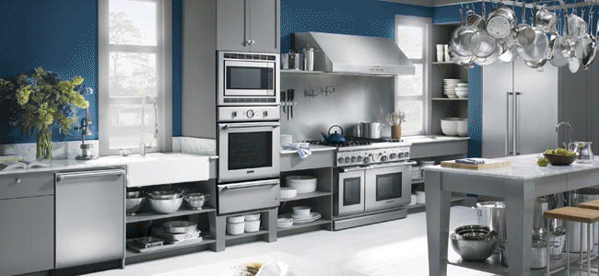
OUR MISSION
To make homes smarter, more connected, and safer for families while helping them save money and converse energy through the power of affordable, automated technology.

Slide 4

FUNDING ALLOCATION
30% Manufacturing
25% Sales & Marketing
25% Key Hires
20% Operational

Slide 5

EASY SETUP
Multi-threat sensor
Remote monitoring
Remote appliance control
Remote shutoff
Advanced notifications
Energy consumtion data

Slide 6
MARKETING STRATEGY
SEO and Social
Content marketing
Influencer marketing.

Slide 7

TARGET AUDIENCE
Homeowners
Residential property managers
Insurance companies.

Slide 8



COMPETITIVE LANDSCAPE
Amazon Echo
Nest Labs
Wallflower Labs

Slide 9
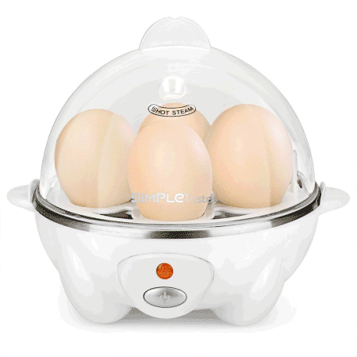

DIFFERENTIATING FACTORS
Diverse poduct capabilities
User-Friendly
Affordability

Slide 10
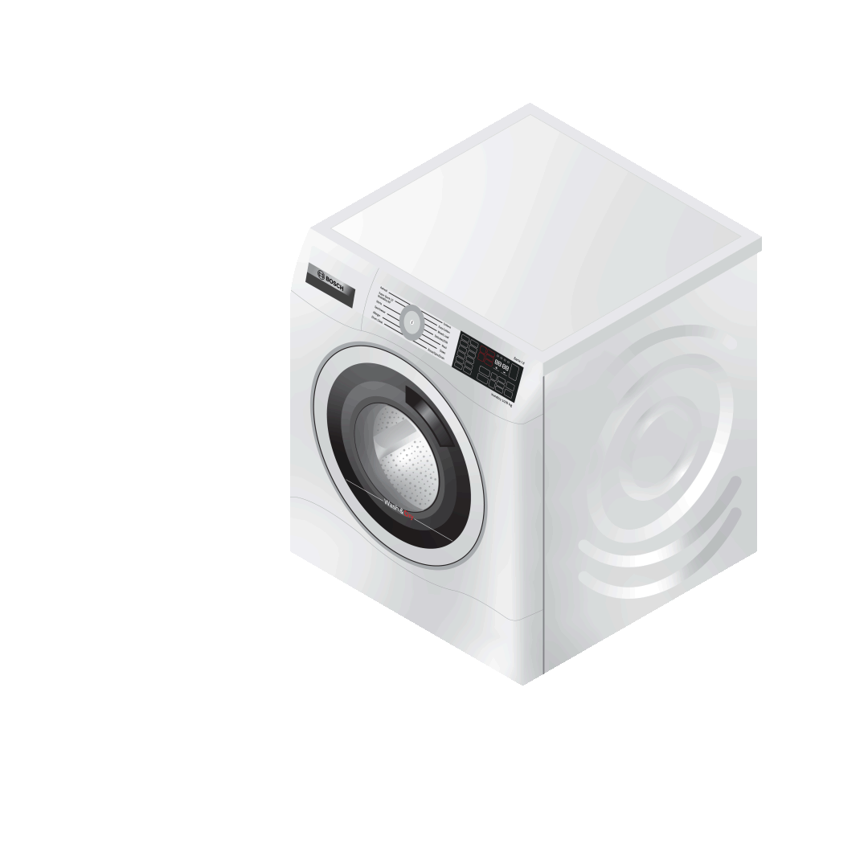
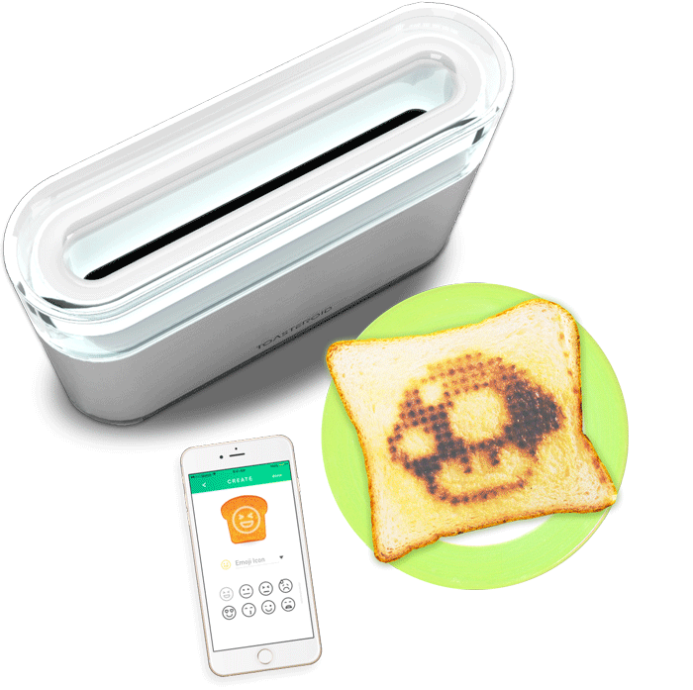
THANK YOU!
BY,
Ravalika.P
Priya Dharshini.B
Vaitheeswari.C
Subashri.P
Divya Bharathi.G.A

